Slide 1


mHealth Introduction
Bob Marshall, MD MPH MISM FAAFP
Program Director, DoD/MAMC Clinical Informatics Fellowship

Slide 2
Learning Objectives
Provide definition
Discuss the history of mHealth
Discuss various aspects of mHealth facilitation, current technology and interoperability
Discuss mHealth in various environments
Review mHealth in research
Discuss the challenges of mHealth
Review the concept of mobile technology policy

Slide 3
Definition
Mobile health (mHealth) is a term used for the practice of medicine and public health supported by mobile devices.
The term mHealth has been defined by the Global Observatory for e-Health of the World Health Organization as:
“medical and public health practice supported by mobile devices, such as mobile phones, patient monitoring devices, personal digital assistants and other wireless devices.”

Slide 4
Some History
The exponential growth of mobile technology in the past few years has created opportunities for mHealth to flourish.
A 2016 Pew study noted: “The vast majority of Americans – 95% – now own a cellphone of some kind. The share of Americans that own smartphones is now 77%, up from just 35% in Pew Research Center’s first survey of smartphone ownership conducted in 2011.”
According to this same survey, adoption of smartphones is about equal among men and women and similar among ethnic groups.
Clearly adoption rates drop with age but increase with education and income.

Slide 5
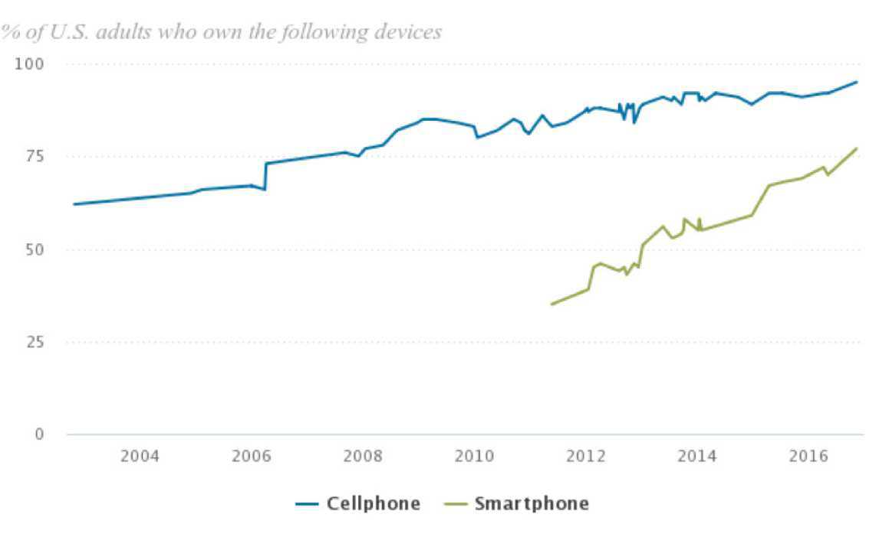
Growth of cellphones and smartphones 2004-2016 (Courtesy Pew Research)

Slide 6
Facilitators of mHealth 1 of
Transmission technologies which enable mobile health applications and devices also include the development of 3G, 4G and soon to be 5G, as well as SMS texting and low energy Bluetooth connections.
The wireless protocol 802.11b became widely adopted for wireless transmission methods.
The combination of connectivity fed the growth of smartphone apps and connected devices through Bluetooth.
This convergence of technology and the opening of the Apple App Store and Google Play, created a marketplace for apps of all kinds.

Slide 7
Facilitators of mHealth 2 of
Other developments which spurred the growth of mobile health include:
Miniaturization of sensors installed in smartphones (e.g., GPS, accelerometers, etc.) and
Bluetooth connected devices, such as, watches, glucose monitors, weight scales and others

Slide 8
Current Mobile Technology
Smartphone apps serve as a platform for several mHealth categories:
First, text messaging (SMS) can be used for a variety of patient reminders
Second, mHealth apps can inform both patients and providers
Third, smartphone sensors e.g. accelerometers can measure activity with the likelihood that more sensors are on the horizon
Fourth, the smartphone can serve as an intermediary platform that collects data that uploads to the cloud where more elaborate tools can be hosted

Slide 9
mHealth Interoperability
Smart phones and tablets work as a platform to not only provide data within apps associated with wireless devices but also transfer that data to the cloud.
This process requires well-tested interoperability standards like the Continua Guidelines.
These guidelines and testing tools outline the transfer of data generated by personal health devices…
Through a personal health device interface (such as Bluetooth),
Through a personal health gateway (most commonly today a mobile phone), then
Through a services interface to a service, and
Then a health information system interface to a health information service (such as, an electronic medical record).

Slide 10
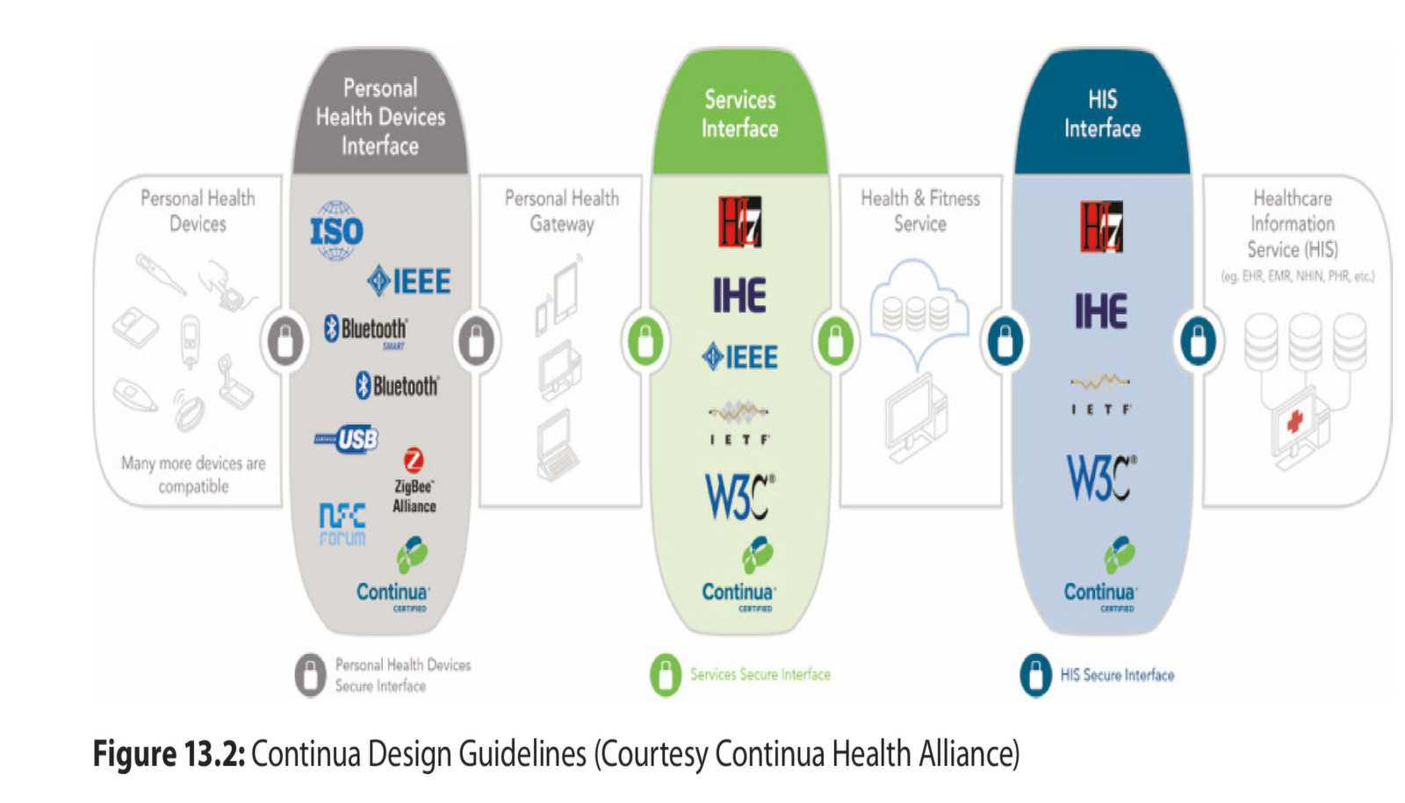

Slide 11
Remote Monitoring Intro
With the broader use of wireless networks in the home and availability of Bluetooth enabled health devices, the use of remote monitoring has expanded
To monitor effectively, not only do the devices need to operate reliably in the home and transmit data through a home network but the healthcare team (often a care manager as the first line of defense) needs decision support systems to analyze potential decompensation of those patients
A requirement of successful use of patient generated health data (PGHD) coming from devices or apps, the data made available to the patient and care team must be analyzed and displayed in a meaningful manner

Slide 12
mHealth in the Clinical Setting
In both hospitals and outpatient clinics, communication is the primary use of mobile devices
mobility has the advantage of allowing the user, whether physician, nurse or other staff, to move from room to room, patient to patient, without dependence on a desktop computer
One concern about the use of mobile technology in clinical settings is infection control, particularly in intensive care units
New smartphone technology allows for not only standard alerts but also the ability to respond to a message by placing an order or other action

Slide 13
mHealth in the Clinical Setting
Data collection is another task which can be enabled efficiently through mobile devices
With the pervasive use of digital imaging in healthcare, viewing imaging results on a tablet has some advantages including the easy ability to zoom in but also take the images anywhere in the clinical setting
Another example of the use of mobile technology in healthcare is for teleconsultations including teleradiology and telestroke services
These services over mobile technologies can enable real time discussion of diagnosis and treatment from an ambulance, plane or remote location

Slide 14
mHealth in the Home
With the incentives from valued-based care, such as, bundled payment models, monitoring patients at home post-hospitalization or surgery is becoming more common
Diabetes is probably the most common condition to use mobile technology to monitor and treat
Virtual diabetes prevention programs with live coaching, social discussions and the ability to record progress have been shown to be as effective as in person programs
Interfaces with electronic medical records through applications programming interfaces (APIs) are being developed to better integrate data from devices and apps into the clinical workflow

Slide 15
mHealth in Wellness & Sports
Fitness trackers are the most common mobile devices and are usually worn on the wrist
The associated apps allow the user to track steps, distance, heart rate, sleep, and diet
Some of the research challenges include failure to define the effect size in digital health, the short duration of the studies and the changes in technology over time
Smartwatches as well as sport-specific devices can be integrated with more sophisticated GPS and other tools

Slide 16
mHealth in Research Apple OS
Apple HealthKit: Apple created the HealthKit, a software development kit (SDK) for iOS and the WatchOS
These application programming interfaces (APIs) integrate a new app with the phone’s health and activity data
Apple ResearchKit: is an open-source framework that enables an iOS app to be used for medical research
The workflow for research, such as enrollment, consent and patient surveys is part of the Kit
ResearchKit is integrated with HealthKit so that health and activity parameters (steps, calories burned and heart rate) can be included in the study

Slide 17
mHealth in Research Android OS
Google Fit: is an app but also includes an Android software SDK, similar to Apple HealthKit for building apps using the activity sensor’s application programming interface (API)
ResearchStack: is a SDK framework for creating research apps using the Android OS, analogous to the Apple ResearchKit
Research Droid: is an Android port of the ResearchKit launched in November 2015 to add Android smartphones to the research platform

Slide 18
mHealth Challenges 1 of 2
Distraction: mobile technology, in particular smartphones and specifically text messaging can be distracting when combined with activities such as driving an automobile
Several studies have confirmed that mobile technology is also distracting in a medical environment
Privacy/security: clearly, mobile technology represents a security risk for patient data and the healthcare system’s network
Source of infection: there is evidence that mobile devices contain bacteria that could be harmful in certain locations such as the operating room

Slide 19
mHealth Challenges 2 of 2
Interference with medical equipment: there is a potential risk of smartphone electromagnetic radiation on pacemakers and other cardiac equipment
Lack of quality control: Due to the proliferation of mobile apps many argued that there needed to be a means to judge the quality of apps, particularly mHealth apps
Lack of evidence: despite more than 500 mHealth studies, there is a paucity of high quality evidence to show that mHealth positively impacts patient outcomes
While the tech industry and developers would like to “scale up” the number of apps, they must first be shown to be effective and there should be agreement as to how the apps should be rated with research

Slide 20
Mobile Technology Policies
Healthcare organizations need to develop a mobile technology policy
Policies should include:
Bring your own device (BYOD) policies to be sure external phones match security policies, encryption, WiFi security, firewall protection, etc
For healthcare system owned phones determine who owns the data
Use separate phones for strictly business use.
Be able to locate phones via GPS
Create “no phone zones”, where appropriate

Slide 21
mHealth Resources
mHealth Evidence. This web site archives more than 8300 digital health evidence sources
https://www.mhealthevidence.org/
NIH Fogarty International Center. Mobile Health information and resources. This NIH website includes news and general information about mHealth
https://www.fic.nih.gov/RESEARCHTOPICS/Pages/MobileHealth.aspx

Slide 22
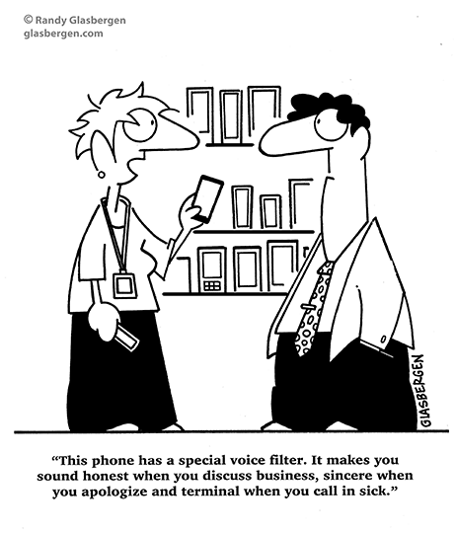
Questions/Discussion

